Slide 1
Artificial intelligence
Jochen Mariën

Slide 2
Hello, I’m…
Introduction
Jochen Mariën (Jochen.Marien@thomasmore.be)
Thomas More college university
ITFactory/Applied informatics
Life long learning centre (http://www.cello.be)
I teach
Data Science (R/Python), cloud AI
PowerShell
SQL, datamodelling

Slide 3
Facilities
Introduction
Day schedule
9h30 – 16h30
Lunchbreak (12h30-ish)
Break in the morning (11h00) and the afternoon (15h00)

Slide 4
About the course
Introduction
Small history lesson
Setting up our IDE
Building our AI-model
Explanation in slides
Running in Jupyter notebooks/python scripts

Slide 5

Two paths
Introduction
You look at the solutions, run them and that is enough for you.
You build the solutions yourself, asking questions and try not to look at the solutions.

Slide 6
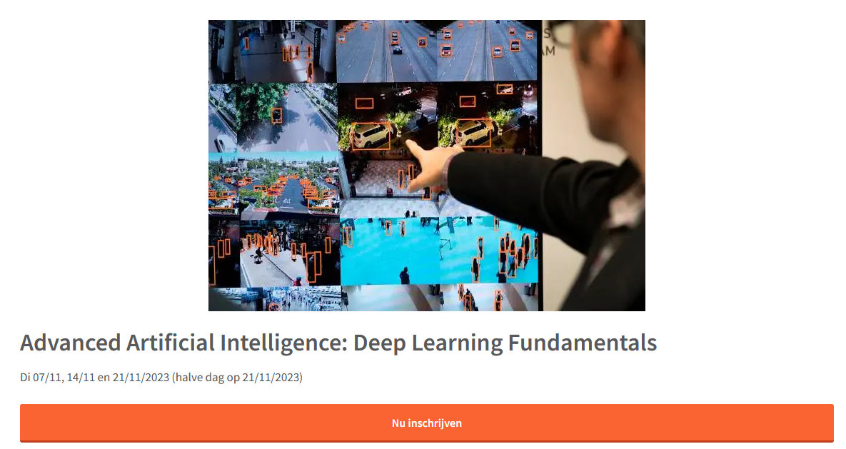
Next?
Introduction
Notes:
https://www.cello.be/nascholing/artificial-intelligence-from-machine-learning-to-deep-learning-3/

Slide 7
Hello, you are…
Introduction
Your name
What you de
Experience
Programming
AI (if any)
Expectations for the course

